Slide 1
“The importance of early diagnostics for a more targeted use of antimicrobials in livestock”
We are pleased to invite you to the webinar on:
25 November 2021, 10:00-12:00h, Microsoft Teams
Click here to join the meeting
This webinar is one of the activities of the DISARM Project - Disseminating Innovative Solutions for Antibiotic Resistance Management and is organized by COPA-COGECA
DISARM project has received funding from the European Union’s Horizon 2020 research and innovation programme under Grant Agreement No 817591

Slide 2
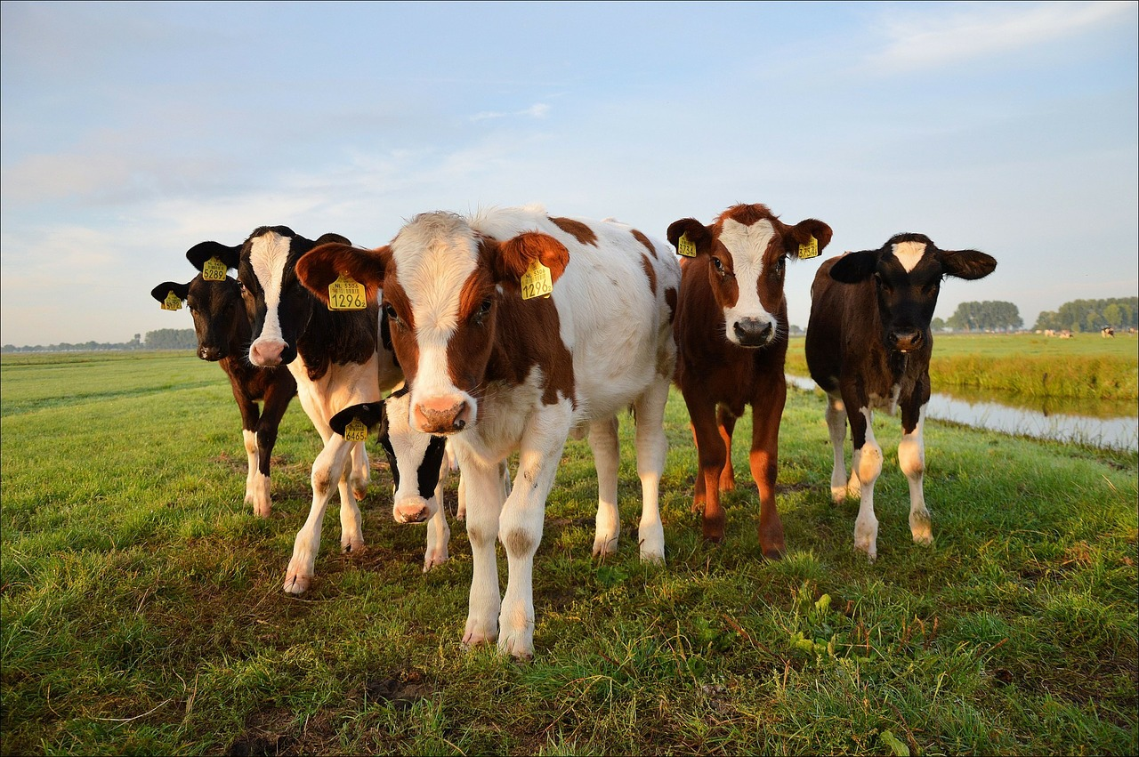
AGENDA
Webinar: “The importance of early diagnostics for a more targeted use of antimicrobials in livestock”
25 November 2021, 10:00-12:00h, Microsoft Teams
10:00 | Opening remarks by Copa and Cogeca (5’)
10:05 | Presentation about Diagnostics for Animals, Jean Louis Hunault (10’)
10:15 | Introduction about the DISARM project (10’)
10:25 | Presentations by: (10’ each)
 | Jean-Luc Troch, IDEXX, Chair of Diagnostics For Animals
 | Anna Vilaró, GSP Lleida, Spain
 | Tommy Heffernan, Vision Farming
10:55 | Q&A, moderated by Roxane Feller (AnimalHealthEurope) and Paula de Vera (Copa-Cogeca) (60’)
11:55 | Closing remarks, Jean Louis Hunault (Diagnostics for Animals) (5’)
DISARM project has received funding from the European Union’s Horizon 2020 research and innovation programme under Grant Agreement No 817591

