Slide 2
Technical & Regulatory Challenges of Developing Veterinary Diagnostic Tests IABS, Wiesbaden, May 15-17

Slide 3
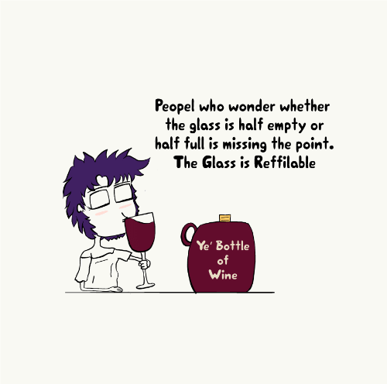
“CHALLENGES”
=
“ ROOM FOR IMPROVEMENT ”

Slide 4
17 members manufacturing over 1350 veterinary diagnostic tools under ISO 9001 or higher QMS https://diagnosticsforanimals.com/

Slide 5
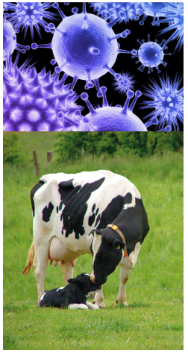
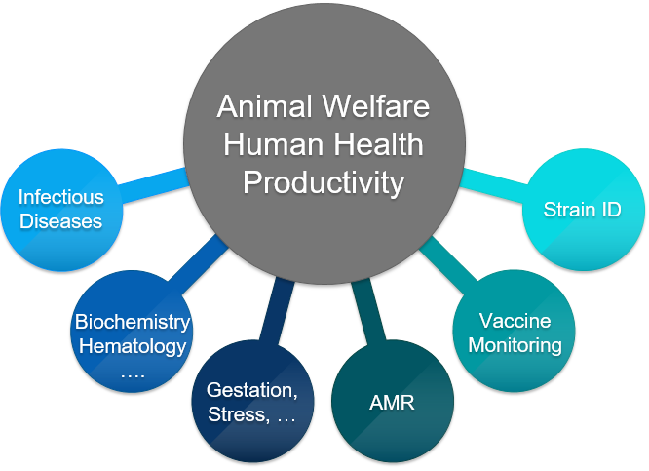
A veterinary diagnostic tool is more than just an “additional cost”…

Slide 6
The development of a diagnostic assay may take up to 3 years*
Phase 1 CONCEPT
Phase 4 QUALIFICATION
Phase 5 TRANSITION
Phase 2 DEFINITION
Phase 3 DEVELOPMENT
Technologies? Ref Methods IP Prototyping | Working on prototypes performances Design-To requirements Patent Applic. | Optimization Specifications Design Verification Pilot Devices Perf vs Specs | Process Validation … Registration Dossier Submission Launch | Post-launch follow up Perf vs Metrics Registration
*Excluding development of equipment, fundamental research
Highly variable between technologies (PCR vs ELISA, Immuno vs biochemistry, …)

Slide 7
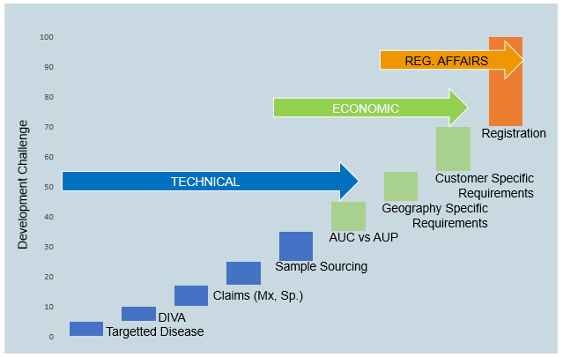
Multiple factors are causing some challenges from the idea to the launch…

Slide 8
Technical Challenges are not always the ones we think about!
Target (Ex. Mpt, m. bovis, …)
Matrix (blood, serum, OF, milk, tissue, feces, …)
Verification &
Validation
(requirements, format, geographies,…)
Species (Multi-, ruminants, …)
Performances
(“fit-for-purpose”,
all-in-one, …)
Protocol (short, rapid, OVN, …)
Individual, pool, tank, …
Sample Sourcing (number, fully characterized, geographies, …)
Platform, DIVA, IP, …
Customer “specific” need…

Slide 9
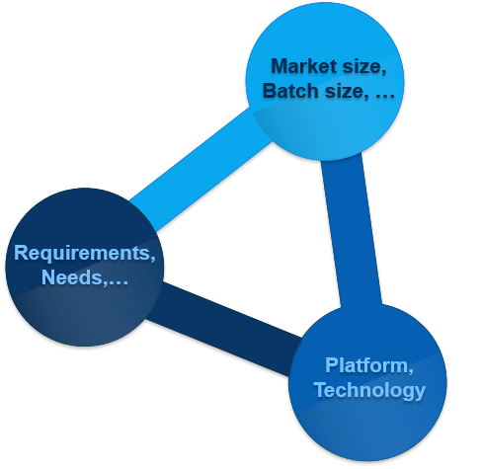
Economic constraints are bringing some challenges too…
Requirements or customer needs (different geographies, customer specific needs, …) leading to multiple different products, different format, and so smaller batch size
Higher cost constraints in certain market (Ex Livestock vs Pets) determines the technology to be used. Advanced technologies used in human diagnostics are not always affordable
There might be a disconnect between the wishes in performances and the acceptable price!
→ Source of some “diagnostic gaps”

Slide 10
Regulatory Affairs drain resources and represents a significant part of the development* of a test, though, we LOVE regulation but… !
Regulatory requirements deduced from pharmaceutical or vaccine guidelines
Cost for registration and maintenance
Language issues, details lost in translation; communication
Contradictory requirements (Ss, Sp, Ref. panels,…)
Definition, maintenance and access to national ref. material
Multiple dossiers/
data formats
Need for “some kind of” mutual recognition
Agencies: from open to no direct contact
Multiple national agencies
GMP ? (MOA)
* Livestock is more regulated than Companion Animal diagnostics, WW (but US, Japan)

Slide 11
We have a dream!
OIE,
FLI (GE),
ANSES (FR),
CVI (NL),
NVRI (RO),
ISCVBM (CZ),
BFSA (BG),
ISCVBM (SK),
AHI,
SCIENSANO (BE),
BLV (CH)
….
USDA (US),
MAFF (JP),
MOA (CN),
Korea
Brazil…
Mutual recognition between agencies
OR
Centralized registration as for TSE with one European Reference Lab taking care of registration of the notifiable disease. It could be one lab per disease
OR
….

Slide 12
Compliance with Environmental Requirements is jumping in the game
BPR
Very few approved substances
Phenol
Ethoxylated
Triton, NP40,…
Sunset in 2021
Micro Plastic Particles
0-5mm
(Traceability)
Substances of Very High Concern (REACH)
What’s next?
Nagoya Protocol – Biodiversity Traceability of biologicals

Slide 13
17 members manufacturing over 1350 veterinary diagnostic tools under ISO 9001 or higher QMS https://diagnosticsforanimals.com/

Slide 14
Thank you for your attention

