Slide 1
Future Innovation in Animal Diagnostics

Slide 2
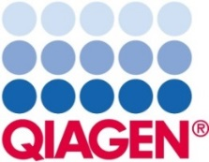
http://diagnosticsforanimals.com
12
14
90%
years
members
Dx market

Slide 3
Federate and represent Manufacturers of Animal Health Diagnostics at Large
Explain the benefit of an harmonized, efficient, and transparent regulatory framework to ensure the future veterinary health industry
Promotes initiatives for the development of Animal Health Diagnostics

Slide 4
Promote INNOVATION and fight against factors that prevent it

Slide 5
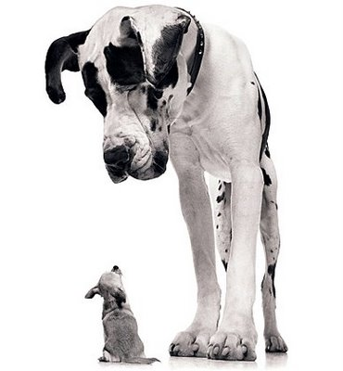
< 10%
Global AH market

Slide 6
Detect and monitor epidemiological risks
Support vaccines & treatments development
Contribute to AH management plans
Warrants quality of produced meat
Define the appropriate treatments
Allows the prognosis of a crisis
Improve animal welfare
PHARMA INDUSTRY
VETERINARY PRACTICINERS
AH AUTHORITIES
MEAT MILK PRODUCTION INDUSTRY

Slide 7
During the last decades technological advances have allowed the meteoric evolution of diagnostic systems
1987
2012
PRRSV
Schmallenberg
4 years to identify the agent
Few months

Slide 8
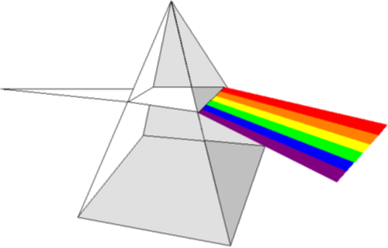
Trends

Slide 9
Trends
ANALYTICAL TECHNIQUES
Onsite PCR tests
Onsite reliable tests
Multiplex PCR
Multiplexing
Massive sequencing
Biosensors
Mass spectrometry (MALDI-TOFF)

Slide 10
Trends
NON INVASIVE SAMPLING
Saliva, milk, hair
Environmental sampling
“Virtual farmer”
Meat juice

Slide 11
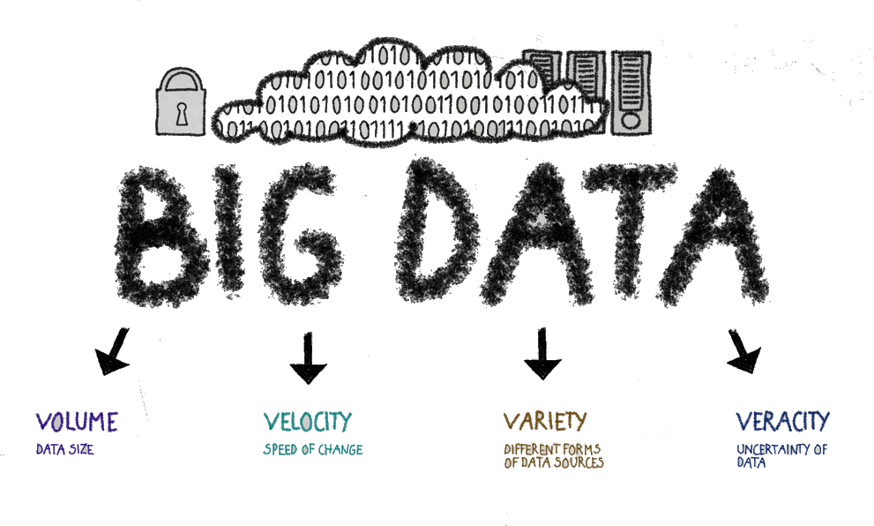
Trends
INFORMATION TECHNOLOGY

Slide 12
Trends
APPLICATION
SOCIAL CONCERNS
Zoonosis
Animal welfare / animal rights
Enviromental impact
Antibiotics resistances, etc…

Slide 13
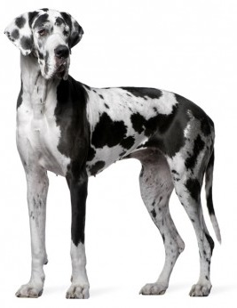
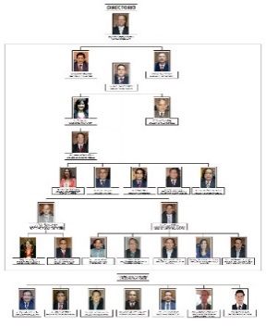
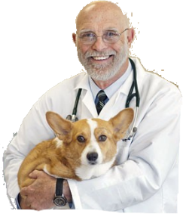
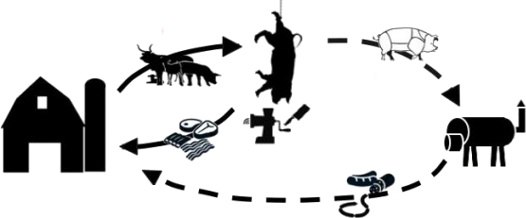
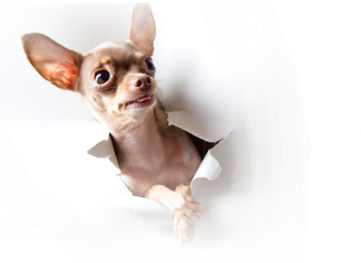
If you want to go fast, go alone, if you want to go far, go together
AH Industry
Meat&Milk production Industry
Vet practicioners
AH Authorities

Slide 14
AH Industry
Compagnion diagnostics
Individual treatments
Population
treatments

Slide 15
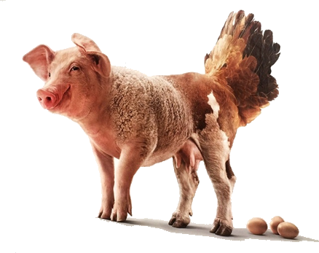
Meat & Milk production Industry
Improvement of herd health management.
Evaluation of sanitary hygiene of producers
Safety of final products.

Slide 16
Vet practitioners
Jointly with AH Pharma, provide protocols for treatments
Individual treatments
Population
treatments

Slide 17
AH Authorities
Regulatory environment for animal diagnostic assays is complex.
Multiple national regulations with no mutual recognition at the EU level.
No exemption of specific regulations, like the BPR (“Biocidal Products Regulation”), because of no AHDx regulation at EU level.
We work together, and with all relevant local and international authorities to move to a more global regulation for AHDx.

Slide 18
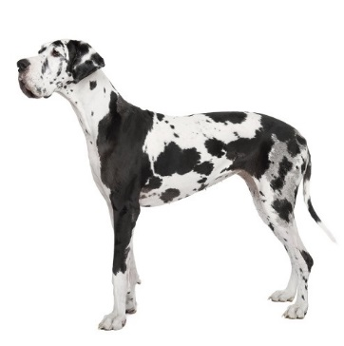
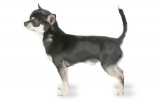
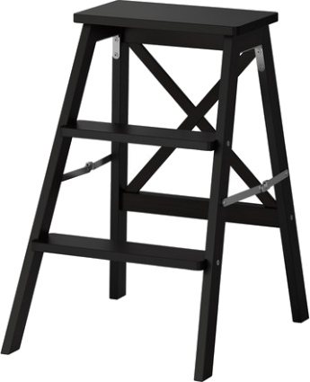
I hope that this journey through the world of diagnosis will help us understand our contribution to innovation and the development of the sector.
Thank you!

